Slide 1
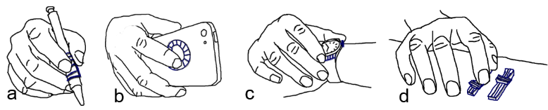
Leveraging on-hand motion sensors and 3d printed widgets to INTERACT WITH everyday things
07/06/2015

Slide 2
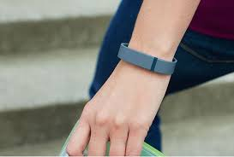
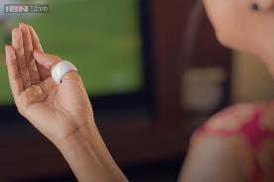
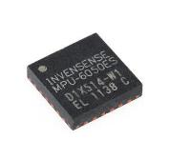
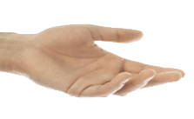
Motivation/Intro
Opportunities
Wearable devices are getting popular.
Most smart watches, wristbands, rings have embedded motion sensors.

Slide 3
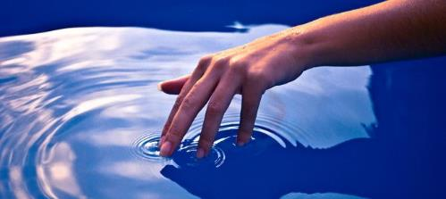
Motivation/Intro
On Hand Motion Sensors
Help transmitting hand motions, as well as hand sensory feelings to computers.
E.g. Vibrations can be detected by accelerometers. Computers can learn more about the objects we are interacting with.

Slide 4
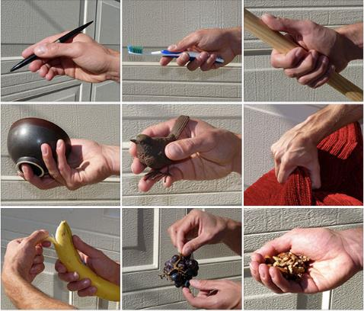
Motivation/Intro
We explore how to leverage the power of on-hand motion sensors to interact with everyday things.

Slide 5
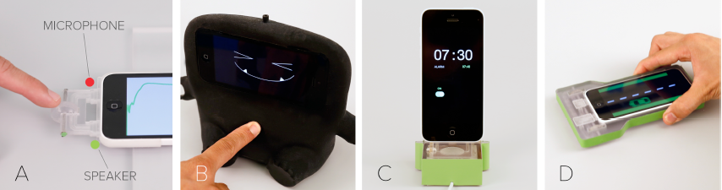
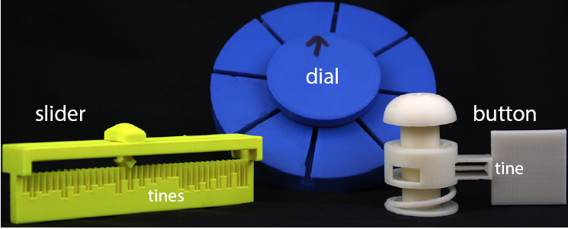
Related Work
Interacting with physical objects (tangible interaction)
Acoustruments
Lamello

Slide 6
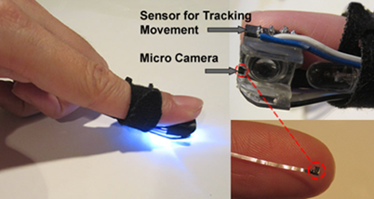
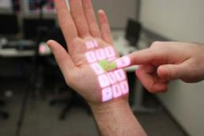
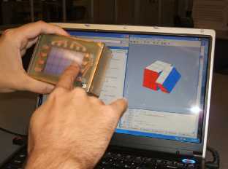
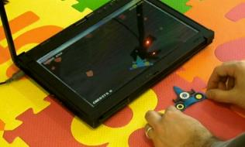
Related Work
Interacting with everyday objects
MagicFinger
OmniTouch
Graspables
Portico

Slide 7
Related Work - Three Challenges
Sensors might not be always available to ordinary objects.
Improper installation of sensors on human body cause discomfort.
The expression capability of hand gestures on physical objects is limited.
Notes:
Installing the sensors might be very complex

Slide 8
Our Work
using existing and emerging wearable devices in forms of watches and rings.
leveraging 3D printed widgets that can be easily attached to ordinary objects.
Sensors might not be always available to ordinary objects.
Improper installation of sensors on human body cause discomfort.
The expression capability of hand gestures on physical objects is limited.
Notes:
Watches and rings are more acceptable to users.

Slide 9
Benefits Brought by the Widgets
The system does not require extra electronic components to ordinary objects.
They are low-cost, and can be easily attached to ordinary objects.
They help providing identifiable touch signals. Common actions such as swiping, tapping, are enriched.
They provide passive tactile feedback. Users’ actions are more deterministic with them.

Slide 10
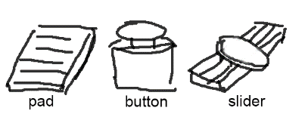





Form factor | Pad Dial Pad Slider Button Scroll
Texture
Spacing
Shape
Height
Length
Uniformity
Direction

Slide 11
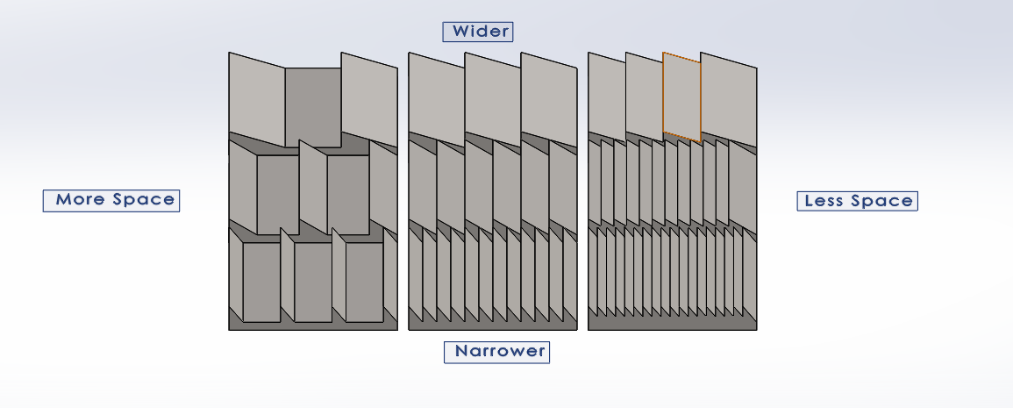
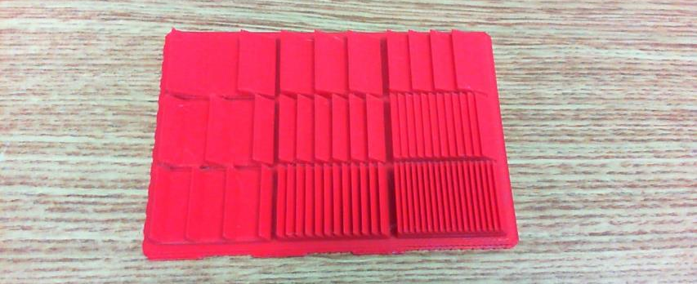
Notes:
This is the important part. Needs more efforts. Make a software to produce cad models for the widgets.

Slide 12
Designing the widgets
How to design the widgets in the way that they can be attached to the other objects.
Make a guideline for designing such widgets.
Implement a software to produce 3d models of widgets.
Users can quickly make their own widgets for certain functions, and play with them.

Slide 13
Recognition - Training
Step 1, 1.5s for users to perform actions
Step 2. Pick 32 frames

Slide 14
Recognition - Training
Step 3. Featurization
Time Domain (4*3 + 2*4)
{ mean, std, skewness, kurtosis }, mean_std
Frequency Domain (16*3)
fft with 32 bins.
sample number is 32, sampling rate is ~66Hz.
each bin stands for 66/32 ~= 2.0625Hz
the first 16 bins for (16 * 2.0625) ~= 33Hz
signal over 33 Hz not being captured.

Slide 15
Recognition
libSVM, with RBF(radial basis function / Gaussian) kernel.
Train with probability estimates.
Predict in real-time. 32 frames moving window, with 12 frames overlap.

Slide 16
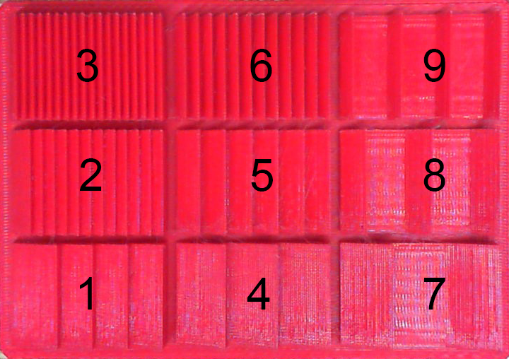
Recognition - Testing
Binary prediction (1, -1) has high accuracy (>98%)
Multi classes predictions, so far get accuracy rate around 80%.
Notes:
4-8-9 2-3-6 7

Slide 17
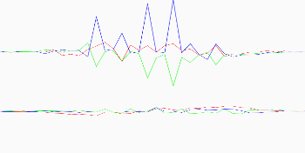
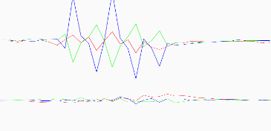
Finds
Signals on wrist are weaker than the ones on fingers.
However, detection result shows no difference.
E.g, for the pad
82.4945% on wrist
81.2819% on finger
For keyboard
>97% on wrist

Slide 18
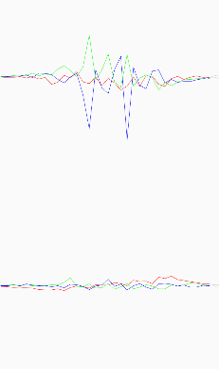
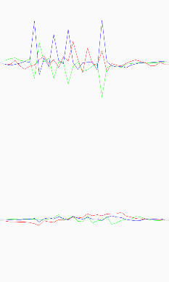
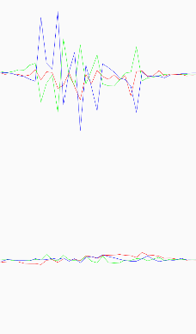
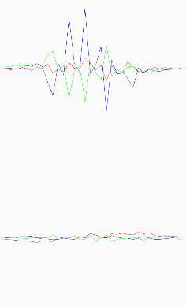
Finds
For the same gesture, accs responds differently.
Notes:
Damp the vibrations. Need to test with different interaction context.

Slide 19
Demo Applications

Slide 20
Demo Applications

Slide 21
Demo Applications

Slide 22
User Evaluation
Human vs Sensors
Can sensors be as good as humans for detecting vibration feedbacks.
Let users design their own widgets.
With the software to design widgets, and to define interactions.
We help them to make those widgets and let them play with them.

